Slide 1
Crime Analysis and Prediction using Optimized KNN Algorithm
GUIDED BY
AISHWARYA T M (2018PECCS105) Mrs.R.DEVI,M.E.,
ASHMIN ANGEL A (2018PECCS111) ASSISTANT PROFESSOR
SRINIDHI ISWARYA B.K (2018PECCS214) DEPARTMENT OF CSE
PANIMALAR ENGINEERING COLLEGE
CHENNAI

Slide 2
INTRODUCTION:
The objective of this project is to tackle a vital issue in the society - Crimes. Analyzing and examining of crimes happening in the world will give us a Broadview in understanding the crime regions and can be used to take necessary precautions to mitigate the crime rates.
Identifying Crime patterns will allow us to tackle problems with unique approaches in specific crime category regions and improve more security measures in society. Current studies show the reason of increase in crime rates is more in areas that are economically backward. In few decades’ property crime will be a target.
The following approach involves predicting crimes classifying, pattern detection and visualization with effective tools and technologies. Use of past crime data trends helps us to correlate factors which might help understanding the future scope of crimes.

Slide 3
LITERATURE SURVEY:
TITLE | YEAR | AUTHOR | CONCEPT | TECHNIQUE | FUTURE WORK | DRAWBACK
Framework For Image Forgery Detection And Classification Using Machine Learning | 2018 | Shruti Ranjan, Prayati Garhwal, Anupama Bhan, Monika Arora, Anu Mehra | the rates of cybercrimes have been surging prodigiously. It has been proven incredibly easy to create fake documents with powerful photo editing soft-wares being as pervasive as ever. | Artificial Neural Networks; GLCM features; Graphical User Interface; Machine Learning ; Support Vector Machine | Will continue to refine the methodology so that there are lesser loop-holes in the analysis and will hopefully come up with a better method in future. | The advancement in the field of science and technology, the introduction of various advance images editing tools are also surging up.

Slide 4
LITERATURE SURVEY
TITLE | YEAR | AUTHOR | CONCEPT | TECHNIQUE | FUTURE WORK | DRAWBACK
Analysis of Counterfeit Currency Detection Techniques for Classification Model | 2018 | Akanksha Upadhyaya Dr. Vinod Shokeen Dr. Garima Srivastava | Counterfeit currency is one of the threats which creates vice to nation’s economy and hence impacts the growth worldwide. Producing forge currency or fabricating fake features in the currency considered to be a crime. | fake currency, classification model, statitical techniques, machine learning, Logistic regression, logit regression, Linear Discriminant Analysis, LDA, feature extraction, detection techniques etc. | The effort is also made to analyze and compare the prediction and classification statistical technique i.e. logistic regression and LDA. Simulation results shows that Logistic Regression gives 99% of accuracy for designing a classification model.. | It is a ever raising issue for research community to identify and detect the counterfeit currency with best possible solution. Hence, detailed study about various techniques based on particular currency denomination has been conducted.

Slide 5
LITERATURE SURVEY
TITLE | YEAR | AUTHOR | CONCEPT | TECHNIQUE | FUTURE WORK | DRAWBACK
Process-induced deformation of L-shaped variable-stiffness composite structures during cure | 2018 | Guiming Zhanga , Jihui Wanga, Aiqing Nib , Haixiao Hub , Anxin Dingb , Shuxin Lib | One of the most key issues for ensuring the accuracy of manufacture and assembly of composite structures reflects on determination of process-induced deformation of composites during cure. | Composite materials; L-shape; Variable stiffness; Process-induced deformation; Spring-in | Previously developed model with the fully 3D thermomechanical model was presented to simulate the process-induced deformation of L-shaped variable-stiffness composite structures | The parameterized L-shaped parts were modeled to investigate the effects of the radius of curvature, the angle, the laminate thickness and the length of flange on spring-in angle of the parts.

Slide 6
LITERATURE SURVEY:
TITLE | YEAR | AUTHOR | CONCEPT | TECHNIQUE | FUTURE WORK | DRAWBACK
Machine Learning Based Anomaly Detection for Load Forecasting Under Cyberattacks | 2018 | Mingjian Cui Jianhui Wang, Meng Yue | Accurate load forecasting can make both economic and reliability benefits for power system operators. However, the cyberattack on load forecasting may mislead operators to make unsuitable operational decisions for the electricity delivery. | Anomaly detection, cyberattack, dynamic programming, load forecasting, machine learning. | This paper develops a machine learning based anomaly detection (MLAD) method for load forecasting under cyberattacks. The predicted load data is first used to reconstruct the benchmark and scaling data by using the k-means clustering. The naive Bayes classification is then used to determine the specific attack template. | In the future, this research can also be further improved by analyzing the sensitivities of different load forecasting methods with the load data tampered with cyber attacks.

Slide 7
LITERATURE SURVEY
TITLE | YEAR | AUTHOR | CONCEPT | TECHNIQUE | FUTURE WORK | DRAWBACK
Framework For Image Forgery Detection And Classification Using Machine Learning | 2018 | Shruti Ranjan, Prayati Garhwal, Anupama Bhan, Monika Arora, Anu Mehra | the rates of cybercrimes have been surging prodigiously. It has been proven incredibly easy to create fake documents with powerful photo editing soft-wares being as pervasive as ever. Documents can be scanned and forged within minutes with the help of these softwares. | Artificial Neural Networks; GLCM features; Graphical User Interface; Machine Learning ; Support Vector Machine | Will continue to refine the methodology so that there are lesser loop-holes in the analysis and will hopefully come up with a better method in future. | The advancement in the field of science and technology, the introduction of various advance images editing tools are also surging up.

Slide 8
PROBLEM STATEMENT: EXISTING SYSTEM
In this system they are proposed logistic regression and K-means classifiers. Researches have been done to study the relation between criminal activities and socio-economic variables like unemployment income level race level of education.
PROPOSED SYSTEM
Property crime more than doubled over the same period. Since the 1990s, however, crime in the United States has declined steadily. Until recently crime prevention was studied based on strict behavioural and social methods, but the recent developments in Data Analysis have allowed a more quantitative approach in the subject. We will explore a dataset of nearly 12 years of crime reports from across all of San Francisco's neighbourhoods, and we will create a model that predicts the category of crime that occurred, given the time and location.

Slide 9
DEVELOPMENT ENVIRONMENT:
SOFTWARE ENVIRONMENT:
Operating System : Windows 7 , 8, 10 (64 bit)
Software : Python and Anaconda Navigator
HARDWARE ENVIRONMENT:
Hard Disk : 500GB and Above
RAM : 4GB and Above
Processor : I3 and Above

Slide 10
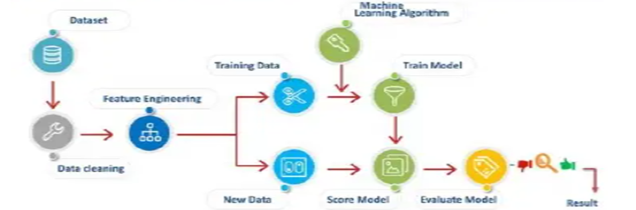
SYSTEM ARCHITECTURE:

Slide 11
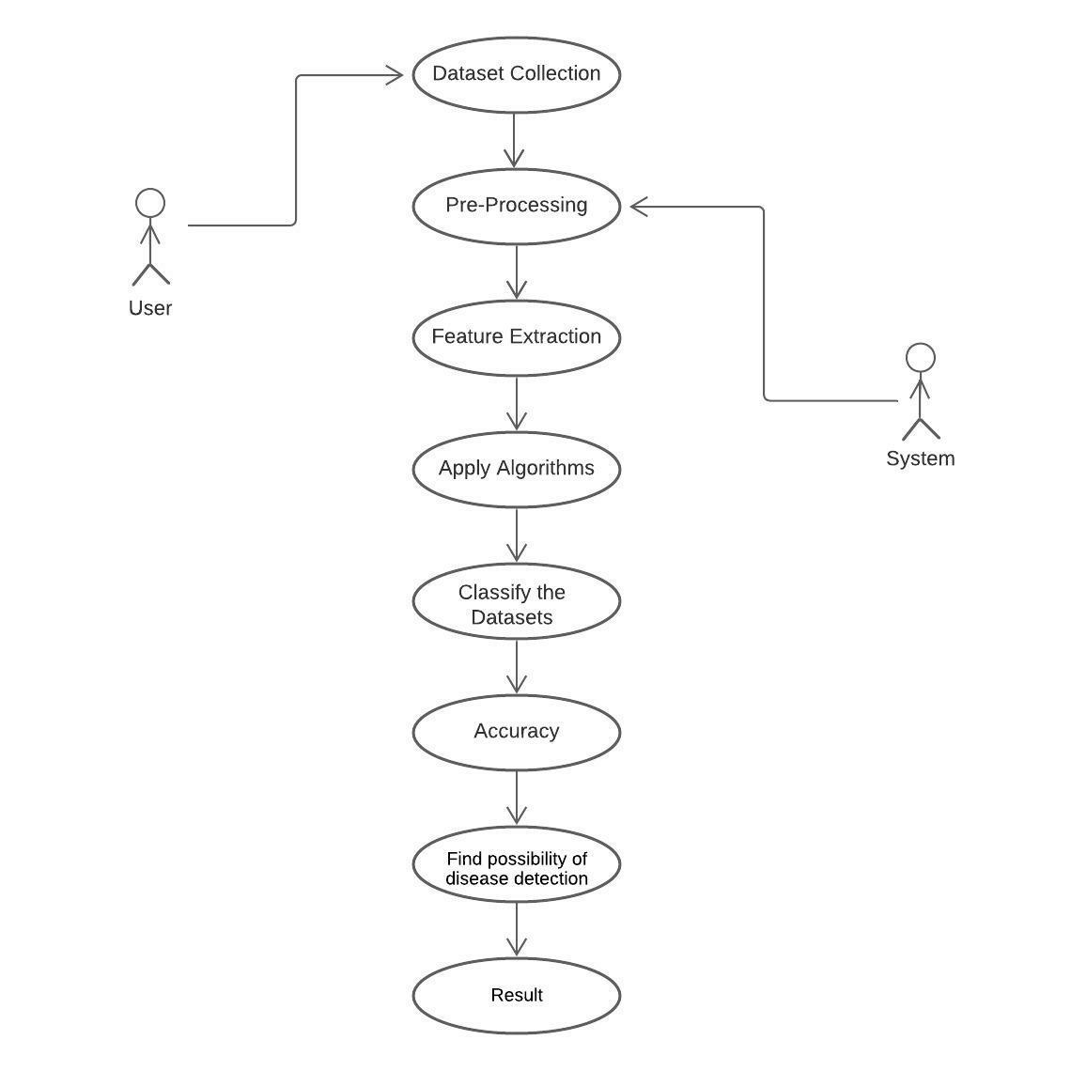
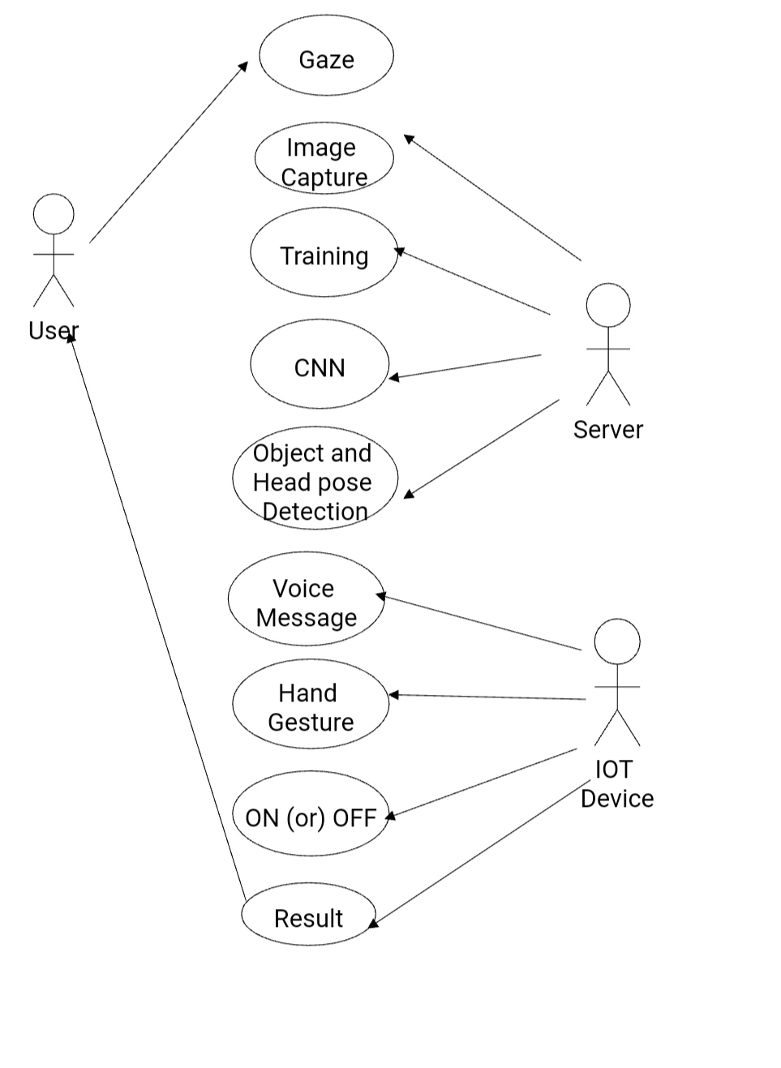
USE CASE DIAGRAM:

Slide 12
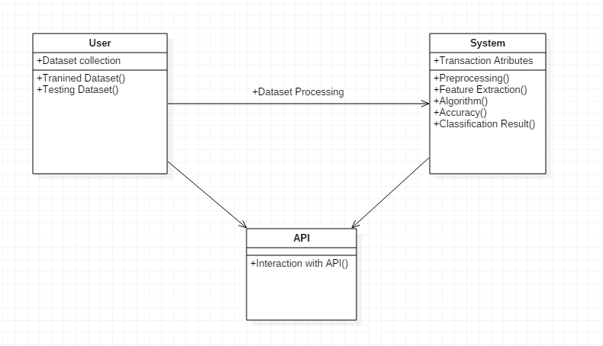
CLASS DIAGRAM:

Slide 13
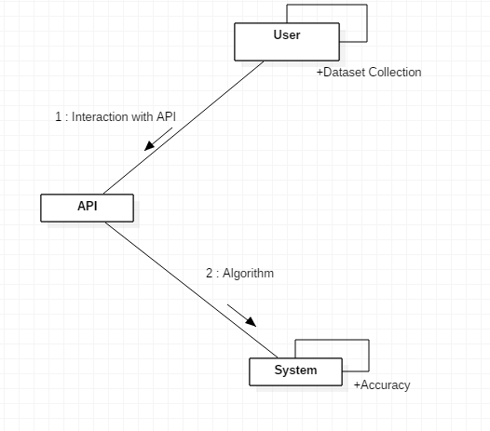
COLLABORATION DIAGRAM:

Slide 14
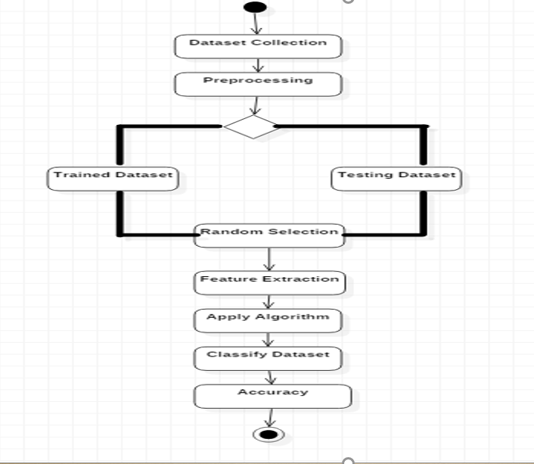
ACTIVITY DIAGRAM:

Slide 15
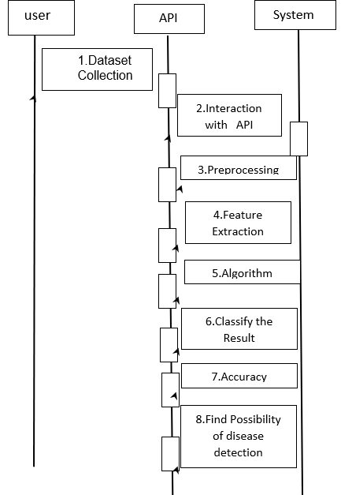
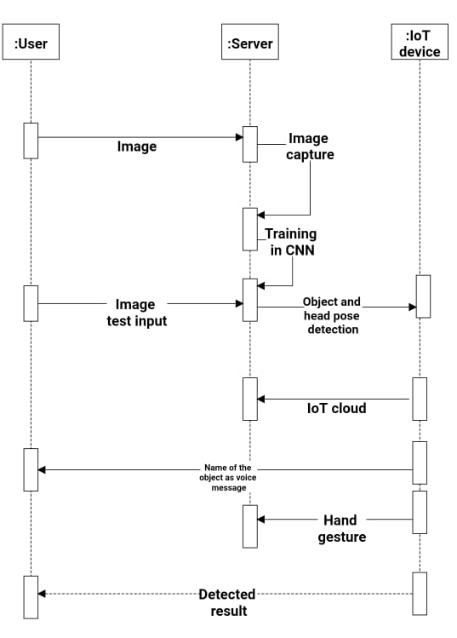
SEQUENCE DIAGRAM:

Slide 16
MODULE DESCRIPTION:
There are four modules in our project .The list of modules are as follows:
DATA COLLECTION
DATA PRE-PROCESSING
FEATURE EXTRATION
EVALUATION MODEL

Slide 17
MODULE 1: DATA COLLECTION MODULE:
Data collection is the process of gathering and measuring information from countless different sources. In order to use the data we collect to develop practical artificial intelligence (AI) and machine learning solutions, it must be collected and stored in a way that makes sense for the business problem at hand. Data for which you already know the target answer is called labelled data.

Slide 18
MODULE 2 : DATA PRE-PROCESSING :
Organize our selected data by formatting, cleaning and sampling from it.
Three common data pre-processing steps are:
Formatting: The data we have selected may not be in a format that is suitable for you to work with.
Cleaning: Cleaning data is the removal or fixing of missing data. There may be data instances that are incomplete and do not carry the data you believe you need to address the problem. These instances may need to be removed
Sampling: There may be far more selected data available than you need to work with. More data can result in much longer running times for algorithms and larger computational and memory requirements.

Slide 19
MODULE 3&4: Feature Extraction And Evaluation Model :
Feature Extraction:
Features selection is done which can be used to build the model. The attributes used for feature selection are Block, Location, District, Community area, like dates, crime description, day of week, X, Y, Location.
Evaluation Model:
In this module we implement the algorithm which one give best accuracy value. Based on that applying the algorithm it should calculate and give the accuracy. Here we are applying the algorithm and get the result on the form of graphical format.

Slide 20
PEFORMANCE ANALYSIS:
TECHNICAL FEASIBILITY: For the real time project, we are using python and the platform used for python is anaconda which is platform independent. Therefore the project is technically feasible.
ECONOMIC FEASIBILITY: This project we are dealing the project in software manner, therefore the cost may be economically high. But in this we are using python programming it reduces the lines of code and increases the performance.
With the rise of violations, law enforcement agencies are requesting more advanced regional data systems and modern information mining methods to help them better investigate corruption and protect their organisations.

Slide 21
CONCLUSION:
In the present study, ML models with machine learning algorithms (ensemble and simile), SVm, SVM-Random forest, SVM-stacking and Naive Bias, were designed and were implemented. Each predetermined factor was feed into a violent crime training dataset (murder, rape, robbery, etc.). We discovered a major conclusion after successfully training and validating simodels.

Slide 22
REFERENCES:
[1] M. Cahill and G. Mulligan, ‘‘Using geographically weighted regression to explore local crime patterns,’’ Social Sci. Comput. Rev., vol. 25, no. 2, pp. 174–193, May 2007, doi: 10.1177/0894439307298925.
[2] J. M. Caplan, L. W. Kennedy, and J. Miller, ‘‘Risk terrain modeling: Brokering criminological theory and GIS methods for crime forecasting,’’ Justice Quart., vol. 28, no. 2, pp. 360–381, Apr. 2011, doi: 10.1080/07418825.2010.486037.
[3] A. Almehmadi, Z. Joudaki, and R. Jalali, ‘‘Language usage on Twitter predicts crime rates,’’ in Proc. 10th Int. Conf. Secur. Inf. Netw., Oct. 2017, pp. 307–310, doi: 10.1145/3136825.3136854.
[4] V. K. Borooah and N. Ireland, ‘‘Deprivation, violence, and conflict: An analysis of Naxalite activity in the districts of India,’’ Int. J. Conf. Violence, vol. 2, no. 2, pp. 317–333, 2008, doi: 10.4119/UNIBI/ijcv.42.
[5] A. Babakura, M. N. Sulaiman, and M. A. Yusuf, ‘‘Improved method of classification algorithms for crime prediction,’’ in Proc. Int. Symp. Biometrics Secur. Technol. (ISBAST), Aug. 2014, pp. 250–255, doi: 10.1109/ISBAST.2014.7013130.

Slide 23
REFERENCES(CONTD..):
[6] P. Pławiak, M. Abdar, and U. R. Acharya, ‘‘Application of new deep genetic cascade ensemble of SVM classifiers to predict the Australian credit scoring,’’ Appl. Soft Comput., vol. 84, Nov. 2019, Art. no. 105740, doi: 10.1016/j.asoc.2019.105740.
[7] Z. Li, T. Zhang, Z. Yuan, Z. Wu, and Z. Du, ‘‘Spatio-temporal pattern analysis and prediction for urban crime,’’ in Proc. 6th Int. Conf. Adv. Cloud Big Data (CBD), Aug. 2018, pp. 177–182, doi: 10.1109/CBD.2018.00040.
[8] A. Almaw and K. Kadam, ‘‘Survey paper on crime prediction using ensemble approach,’’ Int. J. Pure Appl. Math., vol. 118, no. 8, pp. 133–139, 2018. [Online]. Available: https://internal-pdf://107.93.182.66/18. pdf%0Ahttp://www.ijpam.eu
[9] T. B. Hyde, H. Dentz, S. A. Wang, H. E. Burchett, S. Mounier-Jack, and C. F. Mantel, ‘‘The impact of new vaccine introduction on immunization and health systems: A review of the published literature,’’ Vaccine, vol. 30, no. 45, pp. 6347–6358, 2015, doi: 10.1016/j.vaccine.2012.08.029
[10] S. Yadav, M. Timbadia, A. Yadav, R. Vishwakarma, and N. Yadav, ‘‘Crime pattern detection, analysis & prediction,’’ in Proc. Int. Conf. Electron., Commun. Aerosp. Technol. (ICECA), Apr. 2017, pp. 225–230, doi: 10.1109/ICECA.2017.8203676.

